Slide 1
Regression Analysis on Weather Data Using Deep Neural Networks

Slide 2

Group Members
Tabia Morshed
ID : 20200204027
Tanvir Md Raiyan
ID : 20200204034
Musaddique Ali Erfan
ID : 20200204049

Slide 3
Introduction
Weather Forecasting: Predicting future atmospheric conditions such as temperature, humidity, and wind speed.
Focus: Applying Deep Neural Networks (DNNs) to forecast average daily temperatures using historical weather data.
Objective: Enhance the accuracy of temperature predictions compared to traditional statistical methods.

Slide 4
Motivation
Importance of accurate weather forecasting.
Limitations of traditional methods in capturing non-linear dynamics.
Deep learning's potential for better accuracy and real-time updates.

Slide 5

Literature Review
[1] Deep Learning for Stock Market Prediction
Focus: Non-linear regression for stock price prediction.
Challenges Addressed: Capturing complex patterns in financial data.
Result: Outperforms linear regression models on stock datasets.
Key Insights: Demonstrates the potential of deep learning for financial forecasting.

Slide 6

Literature Review
[2] Predicting Agricultural Yields with ML & DL
Focus: Machine learning and deep learning models for yield prediction.
Challenges Addressed: Accurate yield forecasting in complex agricultural scenarios.
Result: Random Forest and CNN achieve highest accuracy in yield prediction.
Key Insights: Highlights potential of DL in enhancing food security through accurate predictions.

Slide 7

Literature Review
[3] Predicting Student Performance with DL
Focus: Regression analysis for academic performance prediction.
Challenges Addressed: Improving accuracy in smaller educational datasets.
Result: DL models outperform linear regression in mean absolute error and loss.
Key Insights: Deep learning can effectively predict academic outcomes and support interventions.

Slide 8
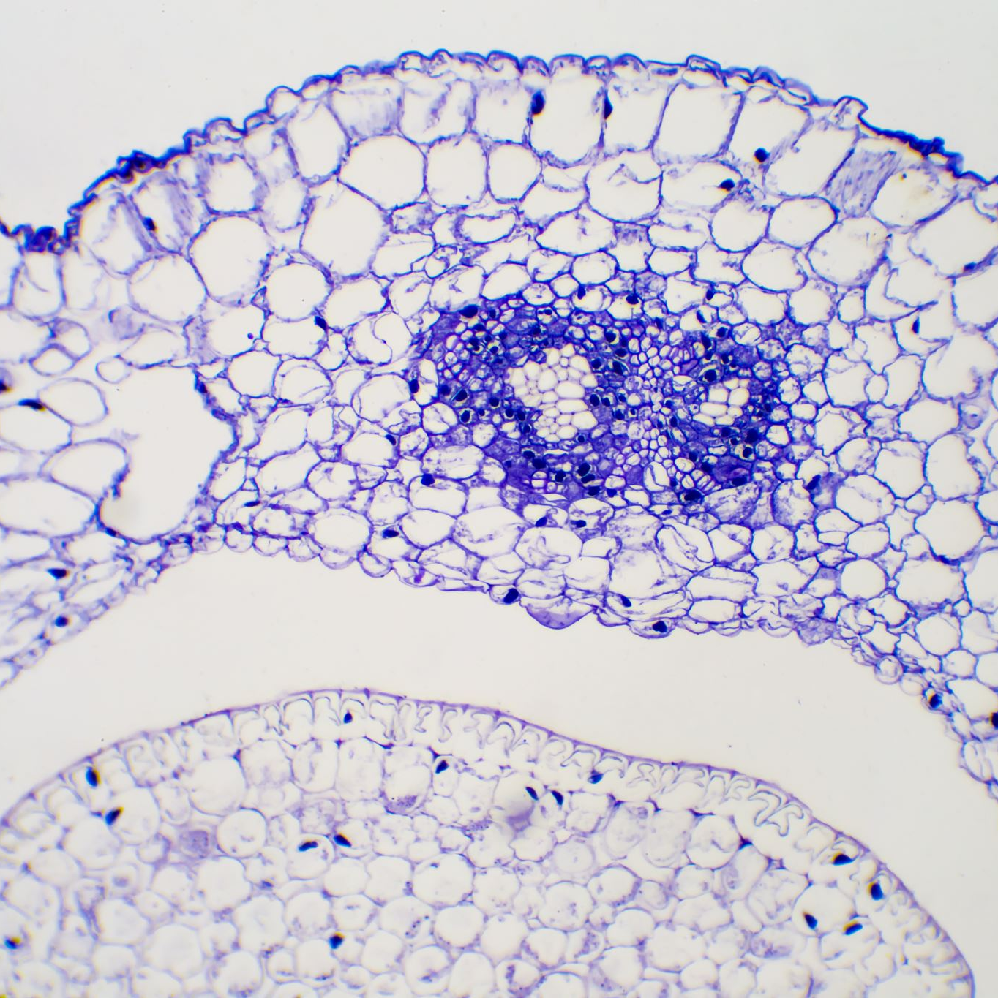
Literature Review
[4] Predicting Dielectrophoretic Force Using DL
Focus: Regression models for predicting DEP force in microparticles.
Challenges Addressed: Accurate prediction of complex physical interactions in Lab-on-Chip devices.
Result: ResNet-50 and AlexNet provide the best performance for different particle types.
Key Insights: Demonstrates deep learning's potential in precision modeling for biomedical applications.

Slide 9
Methodology
Data Preprocessing:
Remove unnecessary features (date, events).
Normalize data using Min-Max scaling.
Model:
Implemented Deep Neural Network (DNN) with multiple layers.
Model Training and Evaluation:
Evaluated using MAE, MSE, RMSE, RMSLE.

Slide 10

Model Overview
Deep Neural Network (DNN):
Designed to recognize patterns and make predictions.
Potential overfitting issues without proper regularization.

Slide 11
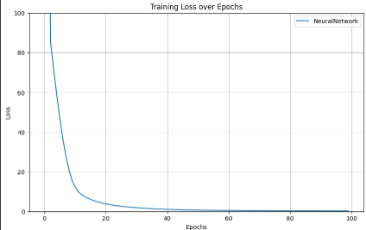
Result Analysis
Model | MAE | MSE | RMSE | RMSLE
DNN | 0.1747 | 0.3249 | 0.4180 | 0.0065

Slide 12
Conclusion
DNNs effectively predict average temperatures.
Deep learning shows potential for improving weather forecasting accuracy.
Valuable insights for sectors relying on precise weather data.

Slide 13
References
Agrawal, S.C. "Deep learning based non-linear regression for stock prediction." IOP Conf. Series, 2021.
Sharma, P. et al. "Predicting Agriculture Yields Based on Machine Learning." IEEE Access, 2023.
Hussain, S. et al. "Regression analysis of student academic performance using deep learning." Education and Information Technologies, 2021.
Ajala, S. et al. "Comparing machine learning and deep learning regression frameworks." Scientific Reports, 2022.

Slide 14
THANK YOU

